Slide 1
Matrix Algebra
MATRIX OPERATIONS

Slide 2
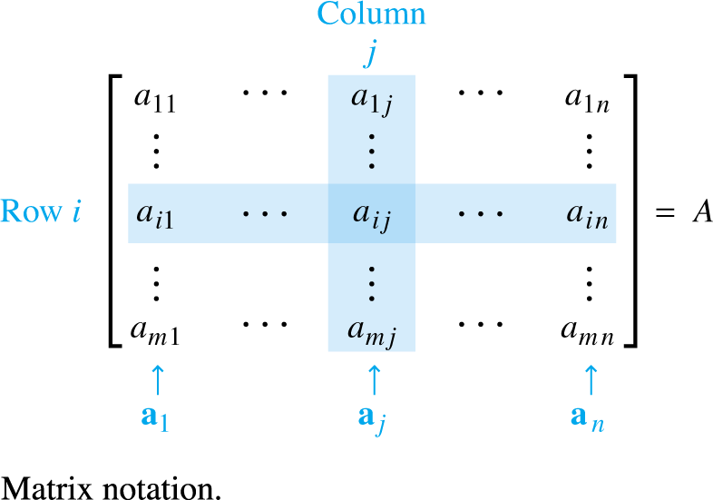

MATRIX OPERATIONS
If A is an matrix—that is, a matrix with m rows and n columns—then the scalar entry in the ith row and jth column of A is denoted by a_{ij} and is called the (i, j)-entry of A. See the figure below.
Each column of A is a list of m real numbers, which identifies a vector in .
$$ℝ^{m}$$

Slide 3
MATRIX OPERATIONS
The columns are denoted by a₁, …, a_{n}, and the matrix A is written as
.
The number a_{ij} is the ith entry (from the top) of the jth column vector a_{j}.
The diagonal entries in an matrix are
a₁₁, a₂₂, a₃₃, …, and they form the main diagonal of A.
A diagonal matrix is an matrix whose nondiagonal entries are zero.
An example is the identity matrix, I_{n}.

Slide 4
SUMS AND SCALAR MULTIPLES
An matrix whose entries are all zero is a zero matrix and is written as 0.
Two matrices are equal if they have the same size (i.e., the same number of rows and the same number of columns) and if their corresponding columns are equal, which amounts to saying that their corresponding entries are equal.
If A and B are matrices, then the sum is the matrix whose columns are the sums of the corresponding columns in A and B.

Slide 5
SUMS AND SCALAR MULTIPLES
Since vector addition of the columns is done entrywise, each entry in is the sum of the corresponding entries in A and B.
The sum is defined only when A and B are the same size.

Slide 6
SUMS AND SCALAR MULTIPLES
Example 1: Let
and . Find and .

Slide 7
SUMS AND SCALAR MULTIPLES
Solution: but is not
defined because A and C have different sizes.
If r is a scalar and A is a matrix, then the scalar multiple rA is the matrix whose columns are r times the corresponding columns in A.

Slide 8
SUMS AND SCALAR MULTIPLES
Theorem 1: Let A, B, and C be matrices of the same size, and let r and s be scalars.
Each quantity in Theorem 1 is verified by showing that the matrix on the left side has the same size as the matrix on the right and that corresponding columns are equal.

Slide 9
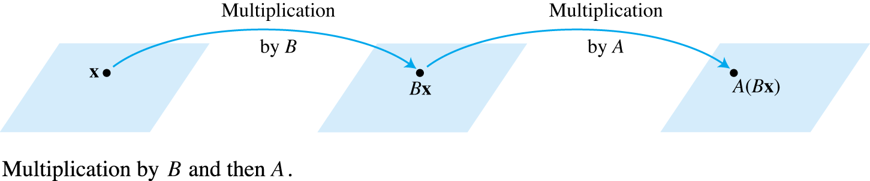
MATRIX MULTIPLICATION
When a matrix B multiplies a vector x, it transforms x into the vector Bx.
If this vector is then multiplied in turn by a matrix A, the resulting vector is A (Bx). See the Fig. below.
Thus A (Bx) is produced from x by a composition of mappings—the linear transformations.

Slide 10
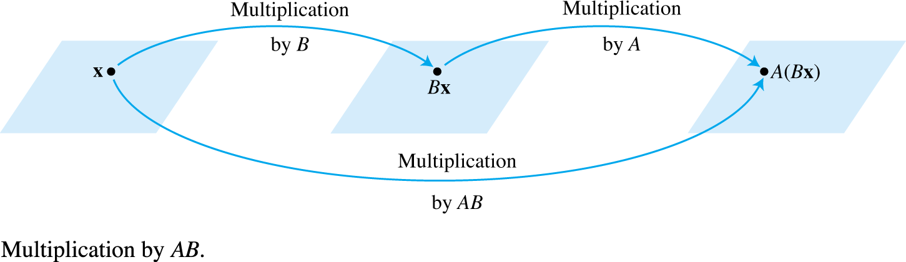

MATRIX MULTIPLICATION
Our goal is to represent this composite mapping as multiplication by a single matrix, denoted by AB, so that . See the figure below.
If A is , B is , and x is in , denote the columns of B by b₁, …, b_{p} and the entries in x by x₁, …, x_{p}.
$$ℝ^{p}$$

Slide 11
MATRIX MULTIPLICATION
Then
By the linearity of multiplication by A,
The vector A (Bx) is a linear combination of the vectors Ab₁, …, Ab_{p}, using the entries in x as weights.
In matrix notation, this linear combination is written as
.

Slide 12
MATRIX MULTIPLICATION
Thus multiplication by
transforms x into A (Bx).
Definition: If A is an matrix, and if B is an matrix with columns b₁, …, b_{p}, then the product AB is the matrix whose columns are Ab₁, …, Ab_{p}.
That is,
Multiplication of matrices corresponds to composition of linear transformations.

Slide 13
MATRIX MULTIPLICATION
Example 2: Compute AB, where and
.
Solution: Write , and compute:

Slide 14

MATRIX MULTIPLICATION
, ,
Then
Ab₁
Ab₂
Ab₃

Slide 15
MATRIX MULTIPLICATION
Each column of AB is a linear combination of the columns of A using weights from the corresponding column of B.
Row—column rule for computing AB
If a product AB is defined, then the entry in row i and column j of AB is the sum of the products of corresponding entries from row i of A and column j of B.
If (AB)_{ij} denotes the (i, j)-entry in AB, and if A is an
matrix, then
.

Slide 16
PROPERTIES OF MATRIX MULTIPLICATION
Theorem 2: Let A be an matrix, and let B and C have sizes for which the indicated sums and products are defined.
(associative law of multiplication)
(left distributive law)
(right distributive law)
for any scalar r
(identity for matrix multiplication)

Slide 17
PROPERTIES OF MATRIX MULTIPLICATION
Proof: Property (a) follows from the fact that matrix multiplication corresponds to composition of linear transformations (which are functions), and it is known that the composition of functions is associative.
Let
By the definition of matrix multiplication,

Slide 18
PROPERTIES OF MATRIX MULTIPLICATION
The definition of AB makes for all x, so
The left-to-right order in products is critical because AB and BA are usually not the same.
Because the columns of AB are linear combinations of the columns of A, whereas the columns of BA are constructed from the columns of B.
The position of the factors in the product AB is emphasized by saying that A is right-multiplied by B or that B is left-multiplied by A.

Slide 19
PROPERTIES OF MATRIX MULTIPLICATION
If , we say that A and B commute with one another.
Warnings:
In general, .
The cancellation laws do not hold for matrix multiplication. That is, if , then it is not true in general that .
If a product AB is the zero matrix, you cannot conclude in general that either or .

Slide 20

POWERS OF A MATRIX
If A is an matrix and if k is a positive integer, then A^{k} denotes the product of k copies of A:
If A is nonzero and if x is in , then A^{k}x is the result of left-multiplying x by A repeatedly k times.
If , then A⁰x should be x itself.
Thus A⁰ is interpreted as the identity matrix.
$$ℝ^{n}$$

Slide 21
THE TRANSPOSE OF A MATRIX
Given an matrix A, the transpose of A is the
matrix, denoted by A^{T}, whose columns are formed from the corresponding rows of A.

Slide 22
THE TRANSPOSE OF A MATRIX
Theorem 3: Let A and B denote matrices whose sizes are appropriate for the following sums and products.
For any scalar r,
The transpose of a product of matrices equals the product of their transposes in the reverse order.

